Slide 1
TSCP Conference

Slide 2
Welcome
Darryn Allcorn, Chair of Executive

Slide 3
Key Note Speech
Nancy Meehan,
Director of Children’s Services

Slide 4
Cordelia Law
Lead Cabinet Member for Children's Services

Slide 5
Continuous Improvement Board and links to TSCP
Claire Burgess, DfE Advisor and LGA regional Children’s Improvement Advisor and Steve Hart, Independent Chair of the Torbay Children’s Continuous Improvement Board

Slide 6
Setting the context nationally
The Social Care Review and National Panel Review (2022) leading to the Social Care Implementation Plan
Reissuing of WT 2023 taking on board recommendations of the Wood Review 2021 into multi-agency safeguarding arrangements

Slide 7
Setting the context locally
Celebrate where you have got to as a partnership – as ever more work to do
Been on a significant and lengthy improvement journey locally – ensuring continuous improvement is critical – the system leading & working together –delivering your ambitions and priorities – how are you doing this?

Slide 8
GOVERNANCE AND INTERDEPENDENCY DIAGRAM TO FOLLOW FROM NANCY

Slide 9
Moving from Inadequate to Good
3.5 years
Initial unrelenting focus on practice and management of Children’s Service
The year 2 watershed moment
Planning for good

Slide 10
Consolidate and Prepare Next Stage
Affirmation from the regulator –we really are good!!
Widening the focus
Improvement for a vibrant Children’s Service
Building the partnership approach
Affirming the assurance function
Agreeing priorities with all partner Boards including the TSCP

Slide 11
Going forward
Continuous improvement through:
Evaluating progress
Assuring quality
Challenge and support
Understanding and responding to the national and local trends
Good is good but outstanding is our achievable ambition.

Slide 12
Setting the context nationally
The Social Care Review and National Panel Review (2022) leading to the Social Care Implementation Plan
Reissuing of WT 2023 taking on board recommendations of the Wood Review 2021 into multi-agency safeguarding arrangements

Slide 13
Setting the context locally
Celebrate where you have got to as a partnership – as ever more work to do
Been on a significant and lengthy improvement journey locally – ensuring continuous improvement is critical – the system leading & working together –delivering your ambitions and priorities – how are you doing this?

Slide 14

Comfort Break

Slide 15
Activity: learning from Arthur and Star
Even table's: What can we do together?
Odd table's: What are the barriers and how can we overcome them?

Slide 16
TSCP – Definition and Purpose
Darryn Allcorn, Chair of Executive

Slide 17
Context
“Local organisations and agencies that work with children and families play a significant role when it comes to safeguarding children.
To achieve the best possible outcomes, children and families should receive targeted services that meet their needs in a co-ordinated way. Fragmented provision of services creates inefficiencies and risks disengagement by children and their families from services such as GPs, education, and wider voluntary and community specialist support.
There is a shared responsibility between organisations and agencies to safeguard and promote the welfare of all children in a local area.”

Slide 18
Context
Working Together Arrangements state that a Safeguarding Partner in relation to a Local Authority Area in England is defined under the Children Act 2004 (as amended by the Children and Social Work Act, 2017) as;
  (a) the Local Authority
  (b) A Clinical Commissioning Group for an area any part of which falls within the Local Authority area; and
  (c) the Chief Officer of Police for an area any part of which falls within the Local Authority area

Slide 19
Structure

Slide 20
Priorities
The partnership has been made stronger this year through key agencies taking the lead in many areas including shaping and leading the work in our priority areas. During the period of Covid-19, the partnership has had to work smarter to ensure that collaboration is continuous. This has meant utilising technology and becoming creative with ways to engage. Key events were held over video conferencing throughout the year.
Partners have faced a number of challenges, and the TSCP has created the space for agencies to be open and honest about challenges and work together to mitigate them.

Slide 21
Role of the TSCP Sub Groups
Sub-group Chairs

Slide 22
Torbay Safeguarding Children Partnership
The Neglect Group
Shaun Evans – Head of Service
(Safeguarding, Early Help, and Business Intelligence)

Slide 23
What is Neglect?
According to Working together to Safeguard Children 2018, neglect is “The persistent failure to meet a child’s basic physical and/or psychological needs, likely to result in the serious impairment of the child’s health or development. Neglect may also occur during pregnancy as a result of maternal substance abuse for example. Once a child is born, neglect may involve a parent or carer failing to:
Provide adequate food, clothing and shelter (including exclusion from home or abandonment);
Protect a child from physical and/or emotional harm or danger;
Ensure adequate supervision (including the use of inadequate care-givers); or
Ensure access to appropriate medical care or treatment.
It may also include neglect of, or unresponsiveness to, a child’s basic emotional needs.

Slide 24
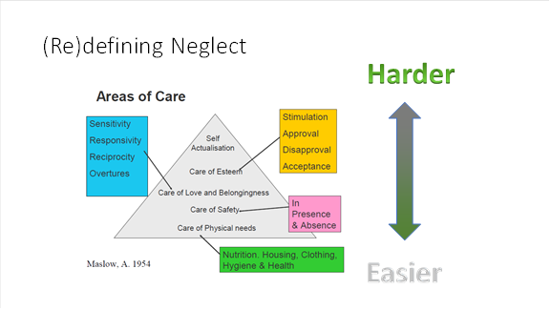
What is Neglect?

Slide 25
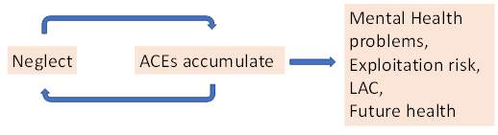
The Impact of Neglect?
Neglect is the most common serious Adverse Childhood Experience (ACE) that has a significant impact on a child’s long-term health, prosperity and wellbeing, as proven by numerous international studies. Neglect also allows other adverse childhood experiences to accumulate, amplifying long term effects for the child.

Slide 26
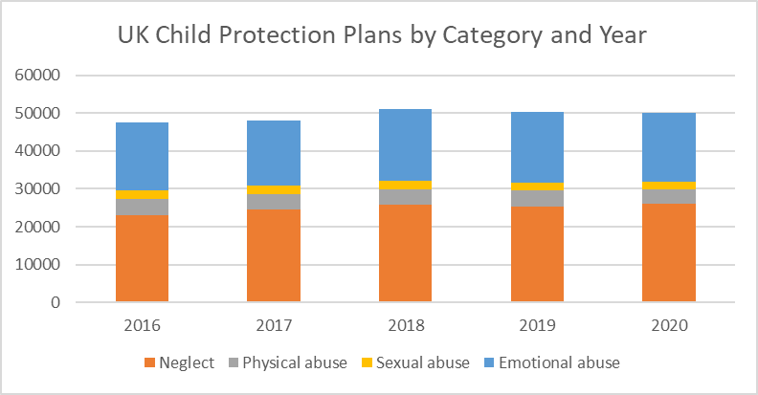
How Widespread is Neglect?
Nationally, neglect and emotional abuse are the most common reasons for child protection plans, the most common reason for children to contact the NSPCC helpline, significant contributory factors to the majority of severe cases of child abuse including those that have resulted in serious case reviews:

Slide 27
The Impact of Covid
Data collected by the NSPCC via their Childline services shows that children’s worries about neglect and emotional abuse account for over half of all contacts. They experienced a 32% increase in contacts during the summer lockdown 2020.

Slide 28
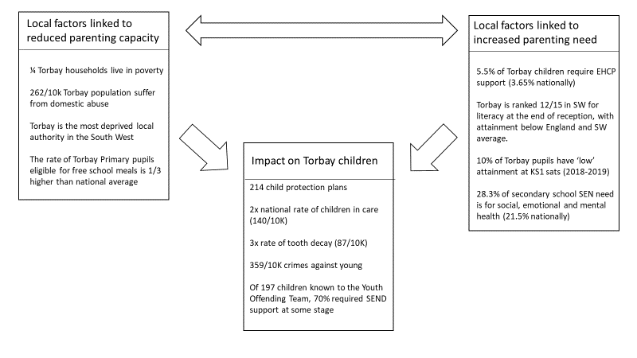
The Story in Torbay
Torbay is a national outlier for both the risk factors for neglect and its impact
*151 Child Protection plans as of 18.01.23

Slide 29
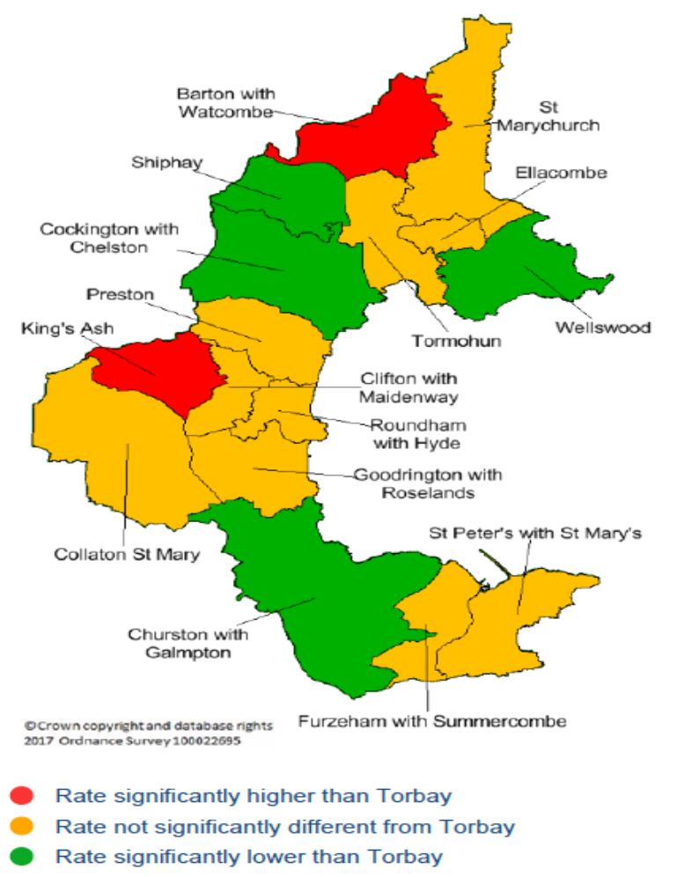

The Story in Torbay
The areas of greatest need for early years support are well localised within Torbay

Slide 30
Learning from Serious Case Reviews
Common Pitfalls when Working with Neglect
According to the national triennial review of serious cases 2019 for Warwick University (Myers 2019), the majority of children suffering from severe harm or death fall into two categories:
The first consists of those unknown to services. Their data show that approximately 1/3 of children seriously harmed are not known to services. These children would be best served by strengthened and accessible universal services, and training universal staff to spot signs of neglect and take an enquiring approach with parents that do not engage.

Slide 31
Learning from Serious Case Reviews
Common Pitfalls when Working with Neglect
The second consists of those known to services, but where a number of common pitfalls have prevented an adequate response. Common themes in local and national serious case reviews:
Professionals do not believe the case will meet a threshold for intervention;
Professionals worry that referral will break any therapeutic relationship they may have with a vulnerable family;
‘Starting again’ (e.g. due to supportive relationship breakdown or staff turnover) and giving insufficient weight to documented risk factors and previous experiences of working with the family;
Insufficient peer support, rigour and oversight;
Disguised compliance and supporting those reticent to engage;

Slide 32

Torbay’s Vision for Change
The aim of TSCP is to promote the welfare of vulnerable children and young people, to maximise their chances of becoming successful and fulfilled adults. The TSCP have a Neglect Strategy Document. The purpose of this document is to outline the vision and guiding principles for TSCP’s restorative practice model that empowers children, parents, communities and universal services to understand and meet children’s developmental needs.

Slide 33
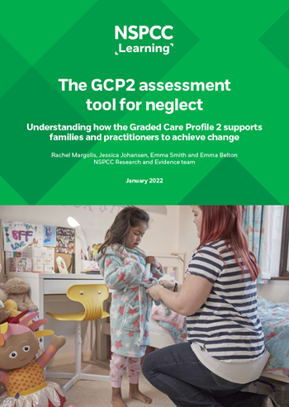
Torbay’s Vision for Change
Using an evidence-based assessment to identify, address and prevent neglect
Graded Care Profile 2 (GCP2) is an assessment tool that helps practitioners take a strengths-based approach to measuring the quality of care a child is receiving and supports them to identify neglect.
Using the GCP2 assessment tool, professionals score aspects of care giving on a scale of one to five. This assessment helps them identify areas where the level of care children receive could be significantly improved.

Slide 34
Torbay’s Vision for Change
Using an evidence-based assessment to identify, address and prevent neglect
Using GCP2, you’ll be able to:
Measure the quality of care being provided to children you work with;
Identify where children require further support and whether the level of care
received needs to be improved;
Implement a constructive working relationship with families;
Increase your confidence in decision making at all levels;
Promote multi-agency working culture by training professionals across agencies to
use the tool – creating a common language and improving the quality of interventions and (where appropriate) referrals.

Slide 35
Torbay’s Vision for Change
GCP2 Rollout Progress to date
In November 2022 practitioners were trained across the Partnership who are now able to train frontline practitioners to undertake the GCP2 assessment
Total number of practitioners trained: 21 plus 18 trainers/ champions
Total number of practitioners trained this quarter: 21 (across two courses)
Number of GCP2s completed this quarter: 1
Information and awareness sessions are being rolled out – first one was on 24.01.23
Target is to have approximately 240 practitioners trained across the Partnership able to undertake the GCP2 assessment.

Slide 36
The Neglect Group
Any Questions?
Shaun.evans@torbay.gov.uk

Slide 37
Domestic Abuse and Sexual Violence
Victoria McGeough
Partnership Lead Manager, Safer Communities

Slide 38

Domestic Abuse and Sexual Violence Operational Group (DASVOG)
An Overview
Victoria McGeough
Community Safety Partnership Manager
DASVOG Chair

Slide 39
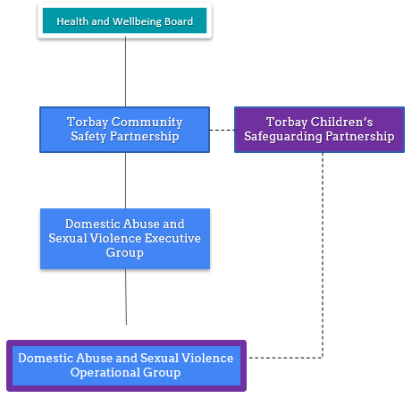

Governance:

Slide 40
Domestic Abuse and Sexual Violence Operational Group (DASVOG):
PURPOSE:
To support and embed a co-ordinated multi-agency approach to effectively minimise the risk of and the harm caused by Domestic Abuse and Sexual Violence in Torbay.
KEY PRINCIPLES
Public Health approach
Strengths-based approach
Trauma informed approach
Whole family and whole system approach
Community approach

Slide 41
Key Subgroups and Links
MARAC Steering Group:
Developed to support, improve and develop the Torbay MARAC.
Focused currently on recommendations from the MARAC Review that was undertaken as part of Torbay’s preparation in for the Domestic Abuse Act 2021.
Standing tall:
Community an Voluntary Sector Partnership that has been developed to drive and develop the community response to domestic abuse and sexual violence.
Partnership work together to respond to a range of identified support needs including:
Family Court support
Counselling
Wider emotional support.
Food Packages

Slide 42
Domestic Abuse Act 2021
DASVOG supports the partnership development in order to deliver the requirements of the Domestic Abuse Act 2021.
This work is overseen by the Domestic Abuse and Sexual Violence Executive Group(DASVEG) which acts as the Torbay Statutory Board as required under the Act.
Key changes made by the Act result in:
A clear definition of domestic abuse being created.
Improved response to perpetrators including enforcement powers.
Improved support for victims.
Creation of new offences and extension of existing ones.
Clear housing duties for victims.
Recognises children as victims of domestic abuse.

Slide 43
Work of the DASVOG 1:
White Ribbon:
In 2022 Torbay Council became White Ribbon accredited. This demonstrates the commitment of Torbay Council to work with internal and external partners to:
Change long established, and harmful, attitudes, systems and behaviours around masculinity that perpetuate gender inequality and men’s violence against women.
To be awarded this a delivery plan was developed and the delivery and monitoring of this plan is overseen and supported by the DASVOG.
CRAFT:
Supported the development and delivery of CRAFT. A relationships based approach to domestic abuse and delivery of the Restore Relationships Programme.
Mockingbird:
Play that explores domestic abuse and the impact on children through drama. This was delivered in education settings and to wider professionals across Torbay.

Slide 44
Work of the DASVOG 2:
DARAC:
Support the training and implementation of the Domestic Abuse Risk Assessment for Children (DARAC) to ensure that there a domestic abuse assessment with a child focus to support assessments and planning for children impacted by domestic abuse.
DA Champions Training:
Overseen and driven by DASVOG.
Harmful Sexual Behaviour:
Members supported in the Task and Finish Group in the development of the Protocols and Procedures.
Funded AIM Training for the Partnership.

Slide 45
Domestic Abuse and Sexual Violence Strategy
To prepare of the implementation of the Domestic Abuse Act 2021 3 key areas of work were undertaken:
1) A Strategic Review
2) MARAC Review (linked to the above)
3) a listening exercise with people with lived experience.
These informed the development of the new DASV Strategy.
The Partnership has agreed that:
The strategy would be a combined strategy to reflect the interconnectivity of sexual violence and abuse.
That the strategy would be a 7 year strategy to facilitate cultural and system change with clear reviews.

Slide 46
Delivery Plan:
The strategy has been completed and the next steps are the delivery plan.
The Partnership have agreed that the delivery plan will be co-developed with key agencies and individuals.
This will give the Partnership more ownership of the plan and the Strategy.
It will also better enable a whole culture and system change.

Slide 47
Serious Violence Duty
Comes into effect on the 31st January 2023.
In requires specified authorities to work together and plan to prevent and reduce serious violence.
To do this specified authorities must:
  Identify the kinds of serious violence that take place in the area (through a Strategic Needs Assessment)
  Prepare and implement a strategy for preventing and reducing serious violence
  Share information and data as required to carry out this work
To do this need a local definition of serious violence and the guidance requires a focus on some forms of youth violence and strongly encourages a focus on domestic abuse and sexual violence.
As such the development of the understanding development and delivery of this Duty will be strongly linked to the partnership response to DASV.

Slide 48

Questions

Slide 49


Children and Young Person Exploitation Group (CYPEG)

Slide 50


World Class Sustainable Policing
CYPEG – Our Focus
Established as a Multi Agency group with a view on one of the TSCP’s Strategic priorities
Prevent child exploitation and sexual harm within the Torbay area and ensure that safety of all children visiting Torbay from these forms of abuse.
Our focus is to develop, review, maintain strategies, processes and resources in regards to
Child Sexual Exploitation
Child Criminal Exploitation
Missing Children
Children who are victims of Trafficking and Modern Slavery
  50
OFFICIAL | FOIA - OPEN

Slide 51
World Class Sustainable Policing
CYPEG – Our Objective
Promote effective working relationships between members, that include colleagues from Health, Police, Council Children services, Education, Voluntary Sector.
Support and guide the development, review and maintenance of multi agency strategies and operations in Torbay to prevent and disrupt child exploitation.
Facilitate the sharing of learning and gain a better understanding of the profile of children, families and the community who are most vulnerable to exploitation.
Respond to themes and trends that have been identified Regionally and Nationally, for example through Rapid reviews.
  51
OFFICIAL | FOIA - OPEN

Slide 52
World Class Sustainable Policing
CYPEG – Our Delivery
CYPEG provides operational governance to -
Multi Agency Child Exploitation (MACE) group
Considers Locations and Perpetrators who present a risk to young people
A Multi Agency Operational group into which Partners can make referrals, share information and agree actions.
Child Exploitation and Missing Operational Group (CEMOG)
Looks at individual young who may be at risk, or persistently missing where there are concerns regarding their activities.
Considers the risk and allocates agreed actions to tackle.
  52
OFFICIAL | FOIA - OPEN

Slide 53
World Class Sustainable Policing
CYPEG – Our Delivery
CYPEG – Our Business delivery plan
Raising awareness of Exploitation in all forms across our communities.
Targeted work to educate – Hotels, Air B&B, Guest Houses, Taxi’s, Food Standards, Sports Group.
Working with the Partnership to commission bespoke Exploitation Training for Colleagues and Partners. Raise awareness of this subject, providing the skills to identify and tackle.
Working to develop a Contextual Safeguarding model for use across Torbay. A framework to guide our response where we have identified issues.
  53
OFFICIAL | FOIA - OPEN

Slide 54
Keith Perkin
Independent Scrutineer

Slide 55
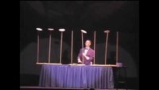
Spinning PLATES

Slide 56
The Challenge From The Independent Scrutineer
Sharing the ambition to become an outstanding partnership.
Openness to change.
Partnership is your ‘day job’.
Understanding the role & perspectives of others, but you can still question.
Creating a narrative where the partnership can demonstrate tangible improvements to the lives of children in Torbay.
How are line managers & leaders stopping the ‘plates from breaking?’

Slide 57
NATIONAL Independent child safeguarding practice review panel
Local Safeguarding Partnerships ‘Inspectorate’, providing an overview of national & local reviews.
Thematic national reviews. Children at risk of exploitation, safeguarding children under 1 from non-accidental injury.
National Child Safeguarding Practice Reviews. Arthur & Star are 2 examples.
Publish an annual review of local safeguarding children reviews.
Publish an annual report.

Slide 58
Key messages from 2021 Review of Local child Safeguarding Practice reviews- Practice
All safeguarding agencies need to promote cultures that give their staff the confidence to ask questions. Staff need to be able to both give and receive challenge and work together to resolve professional differences.
Practitioners need and deserve proper support and resources for their work with some very demanding cases.
The term ‘reluctant and sporadic engagement’ rather sanitises and disguises the realities of working with some extremely hostile and intimidating families and young people, some highly demanding families, and some that are deliberately deceptive.
The detail and realities of day-to-day frontline practice are not usually visible in the reports.

Slide 59
Decision making around reviews (1)
Serious Incident Notification – Local Authority knows or suspects that a child has been abused or neglected AND the child dies or is seriously harmed (Notification lies with LA)
All such notifications where child has been abused or neglected AND death or serious harm occurred leads to Rapid Review. (Joint decision by the 3 Safeguarding Partners)
Rapid review – Gather facts.
Identify immediate learning or action.
Decide whether Local Child Safeguarding Practice Review is appropriate.
Rapid reviews should submit review to National Panel within 15 days of notification.
LCSPR?

Slide 60
Decision making around reviews (2)
More flexibility around commissioning CSPR’s.
Potential to identify improvements to working practices and/or policies.
• Consider potential for national learning.
LCSPRs should aim to identify new learning that is not yet available in local safeguarding systems
They should tackle perennial problems that need further or perhaps different attention.
A LCSPR does not automatically explore learning from a rapid review in more detail. Partners may decide to initiate an LCSPR for this reason.

Slide 61
Quality Assurance SUB GROUP
Harmful Sexual Behaviour
Early Years Providers Audit
Single agency reviews – oral health
In process:
Section 175/157 Schools (Including Academies & Independent settings)
S.11 of the Children Act places a statutory duty on key organisations to make arrangements to ensure that in discharging their functions they have regard to the need to safeguard and promote the welfare of children.
Criminal Exploitation of children

Slide 62

Lunch
Use post cards on your tables to raise any questions to the Executive.
Post these into the box at the registration desk.

Slide 63

Detective Sergeant Karen BUNT
Strategic Safeguarding Improvement Hub (SSIH)
Notes:
Introduction welcome

Slide 64
Introduction
My career:
Essex Police & Devon and Cornwall Police
Response , CID , Child Protection, Review and Inspections, Neighbourhood team, SSIH
SSIH :
Established just over 2 years ago.
Cover the 13+ strands of vulnerability. Support future learning and improvements to the force processes and procedures.
Assist the portfolio holders of the safeguarding strands to facilitate the force business plans and risk registers.
Notes:
A little about me 22 years as a police officer …PC/DC/PS/DS. CP majority of my career so far.
Harmful practices –HBA/Forced Marriage FGM , RASSO , Adults at risk, CAR, child sexual abuse and exploitation , MDS Trafficking , Hate crime , stalking and harassment, Missing Plus Managing sex and violent offenders , Organised immigration crime , Sex work and prostitution

Slide 65
Objectives
To deliver a presentation on current work taking place on Child Neglect within Devon and Cornwall Police
To demonstrate Devon and Cornwall Police activity over the last 2 years in relation to Child Neglect
Illustrate our current situation, identified areas of learning and improvement & what we have planned moving forward
Notes:
Objectives- Ask to deliver a 20 minute presentation of current work on neglect. AS the team member who works on the CAR portfolio.

Slide 66
Devon and Cornwall Police- Neglect
In September 2020 SSIH was a new department
Its main purpose :
to review and action best practice and learning
respond to force recommendations
support the portfolio safeguarding leads with the business plans and risk registers for the particular safeguarding strand
Notes:
Covid – Feb 2020
Child Safeguarding Practice Review (previously known as a Serious Case Review (SCR)) is undertaken when a child dies or the child has been seriously harmed and there is cause for concern as to the way organisations worked together.
"Rapid reviews are a form of evidence synthesis that may provide more timely information for decision making compared with standard systematic reviews." (AHRQ) The methods of conducting rapid reviews varies widely, and are typically done in less than 5 weeks.
High profile cases CSPR, HMIC themes, , forces recs.
Recommendations
National Child Protection Inspections 2019 thematic report - recommends chief constables reduce unnecessary criminalisation of children. Steps could include, considering a child’s circumstances when making decisions; more effective use of legislation to discontinue prosecutions not in the public (or child’s) interest; the development of more effective non-criminal justice pathways for vulnerable children who commit lower level crimes. –(If we can prevent the causational factors at an early stage, we may be able to prevent the criminalisation in the first place)
National Child Protection Inspections 2019 thematic report - Recommend that chief constables should review performance management and quality assurance approaches to ensure that assessments of the nature and quality of decision making are routinely made. The purpose of this would be to reinforce the understanding that compliance with policy or process is only one part of effective practice. (Decision making, assessment and investigation can only be as good as the knowledge and experience provided, we need to equip staff with the right tools to make good quality decisions, to support best practice and best outcome for children.)

Slide 67
Neglect- Background
In Autumn 2021 I started following the court case of both the murders of Arthur Labinjo- Hughes and Star Hobson via media publications. Around the same time I attended a conference on the GCP2 Neglect tool delivered by NSPCC and South Yorkshire police.
In December 2021 we then had the convictions for both Arthur Labinjo-Hughes and Star Hobsons murders and it was at this point more details started to be released of the circumstances leading to their deaths.
I started to look deeper into the two cases and questioned if this is something that could have happened within Devon and Cornwall. I wanted to reduce the likelihood of this, and also minimise the risk of the neglect and abuse that they were exposed to much earlier in their lives prior to their murders.
I wondered what Devon and Cornwall Police response was to Child Neglect and how this could be improved, but I didn’t want to wait for any recommendations or learning outcomes of the child safeguarding practices reviews(CSPR), before we started to map our current performance.
Consulted with the Child at Risk(CAR) portfolio lead and presented the circumstances
Support of the CAR portfolio lead, in early 2022 I Initiated a Deep Dive into our performance and current position as a force in relation to our response to child neglect.
Notes:
Around this time I started to ponder over whether this could happen within Devon and Cornwall , obviously it is, and how could we minimise this happening. About keeping our children safe and not allowing such awful acts to happen within the force area of Devon and Cornwall or at least do our best to minimise the risk as much as possible, About doing everything we can to prevent any such acts in D and C.
I felt the mapping didn’t have to wait for recs I wanted to know the current status quo
Deep dive to mapp and ID any learning needs.
Arthurs Death – June 2020 .(conviction December 2021 – Tustin and Thomas Hughes Murder and manslaughter. )
Star – September 2020. (conviction December 2021)
Arthur and Star late 2021. and NSPCC conference.

Slide 68
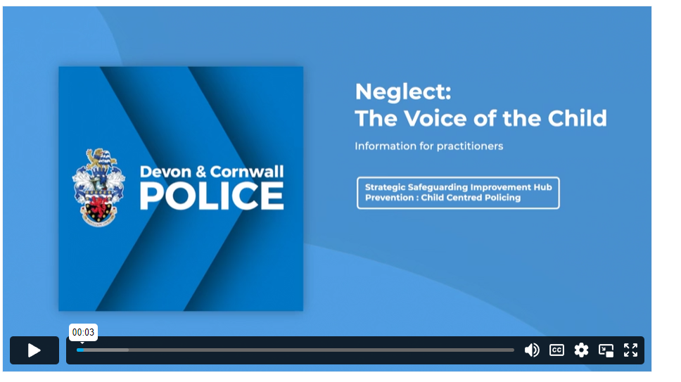
Activity - Early 2022
SSIH Identified common themes from HMIC reports and CSPR including the voice of the child, being professionally curious and understanding disguised compliance.
Recommendations from rapid review (Plymouth) identified similar themes.
Produced a number of products to raise awareness to officers and staff. Training videos(shared more widely with partners), started the development of the PDA(hand held device) Safeguarding ‘App’.
Alongside this we were looking more deeply into our performance and current situation. (Deep Dive. )
Notes:
Alongside this deep dive Other work/activity – review documents /reports best practice , areas for improvements.
Common themes
Couple of short term solutions whilst reviewing our force response.
Early 20220 at the same time as this happened alongside we also have other RR recommendations.
Rapid review – "Rapid reviews are a form of evidence synthesis that may provide more timely information for decision making compared with standard systematic reviews." (AHRQ) The methods of conducting rapid reviews varies widely, and are typically done in less than 5 weeks. – MINI – more quickly collating information and areas where things could have gone better.
CSPR – independent panel commissioned reviews of Serios cases improving learning , professional practice better outcomes
--------------------------------
HMIC Cambridge , Durham, Hertfordshire, Derbyshire , Hampshire- whilst Neglect wasn’t a specific issue key theme across the board was voice of child RIH and Cse /CE missing, And we know there are strong links between Neglect and these forms of abuse and incidents. Neglect is an overarching theme across all reviews.
Star Hobson, 16 months, was killed in care of her mother and violent girlfriend who will today be sentenced
And another child, Ella Rose Clover, was murdered aged 22 months after doctors failed to raise alarm about abuse she suffered
She was taken to hospital nine times in seven months before her death
The cases came after failings by the authorities in the murder of six-year-old Arthur Labinjo-Hughes caused outrage earlier this month
--------------
Baby Harry
The cause of death was unascertained. Whilst the fractures identified led to the conclusion that Harry had been physically abused this did not cause his death. Neglect, as a significant contributory factor cannot be excluded.
Isobel Cooper- on and off child protection plans , cross boarder. Good response from Police D and C but could it have been prevented.
- There are evidential studies that show a correlation between child neglect and other forms of child abuse. It is thought Neglect if left to manifest can develop into other forms of abuse, Evidential studies also show links between child neglect, child exploitation and criminalisation.
- Neglect is an overarching theme across recent national HMIC reports particularly in relation to child exploitation, criminalisation of young people and missing. (add in the HMIC reports)
---------------------

Slide 69
Deep Dive
National data
Deprivation data
Review of rapid reviews, CSPR and HMIC reports
Local data including crime data integrity and outcomes –Dip sampled
Mapped our activity in relation to Neglect and training through learning and development, looking at what areas and departments provide to support their staff. CRC, LPA, PPU, L and D, COP
Benchmarking with other force areas and also partnerships including NSPCC and local authorities and charities
GCP2 and SHARRED – awareness and knowledge
Workshop (December) – various departments and staff.
Notes:
WHAT DID don’t give findings yet
- National DATA- Iquanta data – shows comparison to other forces. In 2020 the office of national statistics reported that Neglect was the most common category for Child Protection Plans in England(25,330 at 31st March 2019 out of a total of 51,510).
2020 Cornwall- 414 (210) devon 498 (245) Plymouth 255 (121)
- Research – exploring the relationship between neglect and CSE Elly Hanson edited by steve flood and Dez Holmes.
-
Deprivation can impact on child abuse and Neglect (CAN)- D and C have high pockets of deprivation areas, don’t forget affluent abuse.
The relationship between poverty, child abuse and neglect: an evidence review
P. Bywaters, L. Bunting, G. Davidson, J. Hanratty, W. Mason, C McCartan, N. Steils
the review aimed to investigate two central issues. 1. To what extent is there evidence that poverty increases the amount of child abuse and neglect (CAN), and/or affects the nature of child abuse and neglect? How does this occur, how large are these effects and to whom do they apply? 2. To what extent is there evidence that CAN increases poverty later in life, how large are these effects and to whom do they apply? Within these two issues evidence about equality and diversity, and cost were considered throughout.
RR CSPR HMIC – common themes learning objectives
HMIC Cambridge , Durham, Hertfordshire, Derbyshire , Hampshire- whilst Neglect wasn’t a specific issue key theme across the board was voice of child RIH and Cse /CE missing, And we know there are strong links between Neglect and these forms of abuse and incidents. Neglect is an overarching theme across all reviews.
Star Hobson, 16 months, was killed in care of her mother and violent girlfriend who will today be sentenced
And another child, Ella Rose Clover, was murdered aged 22 months after doctors failed to raise alarm about abuse she suffered
She was taken to hospital nine times in seven months before her death
The cases came after failings by the authorities in the murder of six-year-old Arthur Labinjo-Hughes caused outrage earlier this month
Local DATA
DIP DAMPLE Q and A – COP – definition of neglect , Crime standards re when to crime and threshold
CPP – 50 % CPP Neglect
Outcomes 2020 415 positive outcomes 56
ADULT SIMPLE CAUTION
CHARGED
COMMUNITY RESOLUTION
PATHFINDE
R - DEFERRED CAUTION
PATHFINDER - DEFERRED CHARGE
POSTAL REQUISITIONED
GCP2(Graded Care Profile) Training Event January 2022 (NSPCC) input highlighted South Yorkshire police -reviewed their response to child neglect in 2020 and working in collaboration with the NSPCC developed assessment tool and one day training package. They report positive feedback from all officers trained so far and an increase of 40%of vulnerable referrals and 24% increase in Neglect crime. (see iquanta data) Note: NSPCC want at least £40,000 for use of the assessment tool)
North Yorkshire and Derbyshire and COP
Children Society
WORKSHOP –delivered /conducted

Slide 70
FINDINGS
Identified opportunities to better record crime.
Established crime outcomes could be improved. (ie positive disposal Community resolution, Charge)
Limited training and awareness was given to relevant staff.
Acknowledged we needed to improve investigation standards - Recognising the signs and identifying supporting evidential material
Considered threshold levels and how they contrast between agencies, including CPS with criminal threshold, and local partnership threshold levels for criminal neglect.
Recognised Control Room staff have limited assessment tools to support initial reporting – missed opportunities
Aware of other force’s position and how they had introduced mandatory Neglect training for all front line staff
Understanding of the GCP2 product supporting local authorities response to Child Neglect
No college of policing product currently available
Notes:
Opportunities to better record crime – recording incidents as crimes rather than information . Outcomes 2020 415 positive outcomes 56
ADULT SIMPLE CAUTION
CHARGED
COMMUNITY RESOLUTION
PATHFINDE
R - DEFERRED CAUTION
PATHFINDER - DEFERRED CHARGE
POSTAL REQUISITIONED
Of the crimes we were criming there was defiantly opportunity to improve the outcomes/disposal.
CRC – initial reporting,
response NHT ARV etc
Also identified areas for improvement with investigation – initial attendance and the ongoing investigation., identification and capturing key evidence early and how to present to CPS. Knowing what to look for
Maximise evidential gathering process and how we deliver that to CPS
Threshold levels – evidential thresholds differ want to get better understanding of this,
GCP2 – reviewed the product to gain an understanding and train the train to ensure working together with partnerships – all Local partnerhships in D and C have adopted the tool
COP – SCAIPIP - specialist officers , new recruits a few modules embedded within Vulneribilty section but not detailed this would not truly embed the learning and understanding.

Slide 71
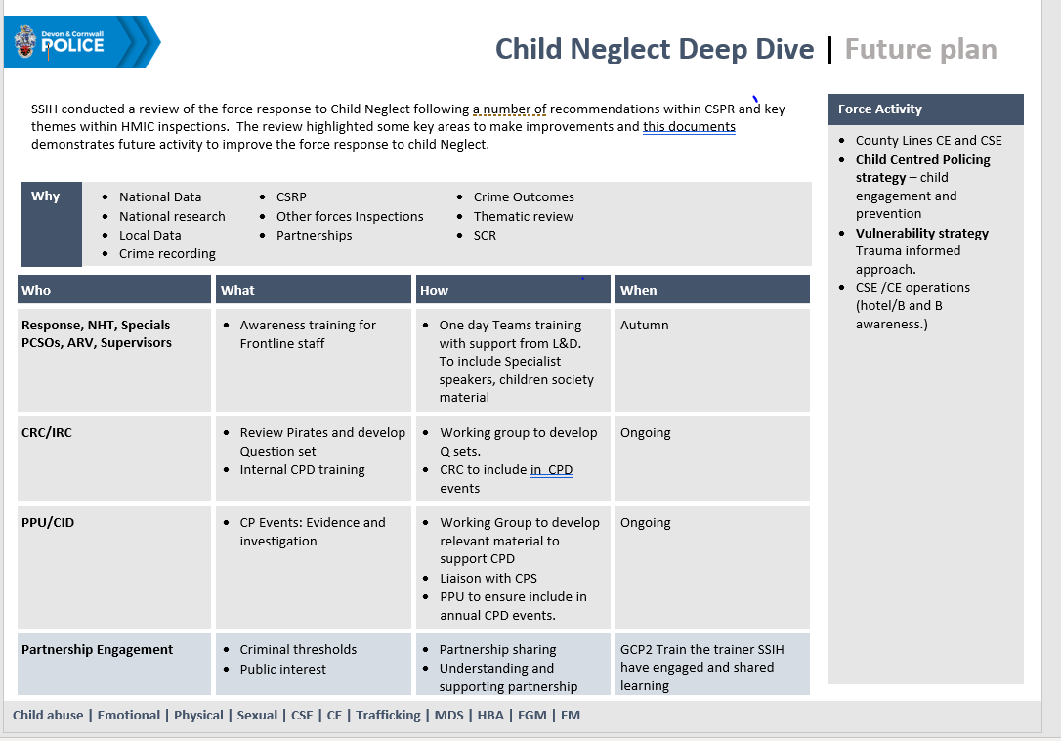
Specific finding from the workshop with Staff
Notes:
Wanted to summarise one one page the finding on the workshop to direct future activity and make it meaningful
Demonstrated here and didn’t want to ignore them we want to ensure all the main themes were addressed moving forwards.
WORKSHOP - Of the findings I wanted to summarise them on one page in order to consider how we could address the themes raised. Include a slide here just to demonstrate our considerations
Some are easier than others to address.
Didn’t want them to get ignored so developed a Neglect future operational plan to direct our activity moving forward to make it meaningful and actually address the themes raised.
: also record the how and considerations moving forward.
Have included a slide to explain the finding the workshop highlight plan moving forward. – put it on a page because elements of this were things I hadn’t thought about and I wanted to ensure that other themese identified also formed part of this review process. And they were considered.
TRAINING

Slide 72
Main areas to focus on:
Front line staff - Training – awareness and referral process
Support for specialist departments (PPU /Control room – CPD, support material)
Notes:
Of the findings of the deep dive : the main areas we want to focus on initially – training of frontline staff and supporting the other departments that are key to such incidents and investigation

Slide 73
Current position
January 2023 – Business paper submitted to vulnerability business board to seek support for a one day mandatory training package for all front line staff. (around 2000 staff) – This has been supported.
Progress activity documented in the neglect future plan, to address other areas of improvement identified.
‘App’ – developing an ‘App’ for front line staff to support them at incidents via their PDAs(hand held devices), and to reinforce and support the learning from the front line training
Notes:
. Agreed SENIOR officer further enhanced frontline awareness training
VBB governance board that review drive support activity around the strands of vulnerability links in to the partnerships . Reviews strands at force level to deliver on the overlay vulnerability plan .
To improve awareness and referral procedures. Ie PPN, MASH/MARU etc. to ensure information sharing is detailed and accurate. This was agreed with aspirational delivery for Autumn 2023 (around 2000 staff)
Neglect future plan – to address other ID themes including initial reporting, evidence gathering and investigation standards, including threshold levels for CPS cases.
APP – VOICES RESPOND tool kits referral processes MASH form

Slide 74
Moving forward
Consultation with Learning and development to support the delivery of the frontline training
Continue development of the APP –reinforce the learning and provide support network
Progress the action on the future neglect plan – inter departmental learning and CPD
Force recommendation team: Robustly manage continuous improvement from recommendations.
SSIH to continuously analyse and review CSPR and other strategic reports to identify key learning areas to improve process and practice.
-----------------------------------------------------
Aspirational we would like a partnership approach and be able to deliver a training package to all professionals that may come in contact with children, ie Housing, Fire, Health, education CYPS. To address the awareness but also the element of criminal neglect and threshold levels for this.
Notes:
With a few to roll out autumn 2024
APP - Reinforce learning , referral processes etc
Neglect plan – in liaison with internal department to support and produce products to address other areas identified , and support staff in awareness , questions sets assessment tools, etc.
Dedicated Team - Force recs team – feed into them and they feed to use – continuous consultation
analyse and ID and record recs feed into and they feed to us to support the identification of learning opportunities and forcewide improvement
Address findings, working at pace and strict feedback inspirationally Autumn

Slide 75
Outcomes /Summary
To demonstrate Devon and Cornwall Police activity over the last 2 years in relation to Child Neglect Deep Dive
Deep Dive
Voice of the child/Professional curiosity training videos
Safeguarding APP
Illustrate our current situation, identified areas of learning and improvement & what we have planned moving forward
Development of the front line training on Neglect
Development and activation of the SG APP
Neglect Future plan – to address other areas of improvement identified from the workshop
Notes:
Objectives

Slide 76
Thank you

Slide 77

A Family perspective
Bruce Bell, Public Health Consultant, Torbay Council

Slide 78

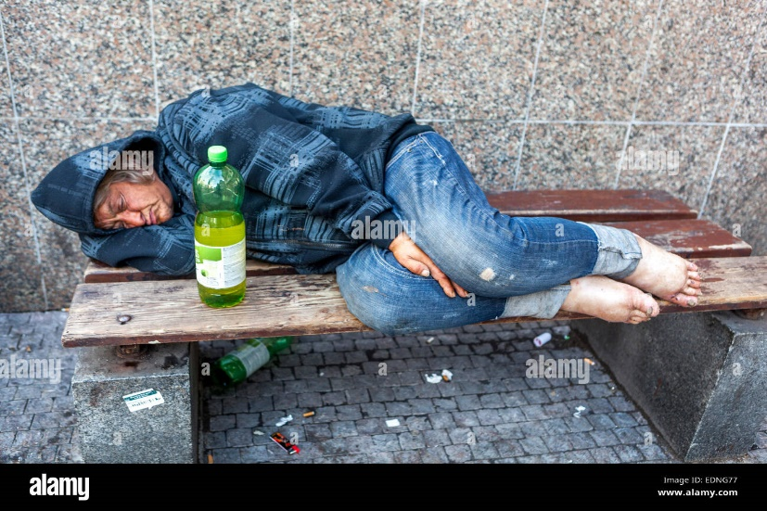
Alcohol Consumption
Notes:
There is a common stories we tell in our society that the ills of alcohol are due to:
Young people
And those who are alcohol dependent
These are the archetypes we like to project blame and ‘otherness’ on to:
The inebriated young person who causes havoc or is too drunk to walk
The destitute who drink
The drunk mother at the school gates
The stories and the reality are often different.
The evidence doesn't always sit with the perception
And this can be uncomfortable for us as professionals and people

Slide 79
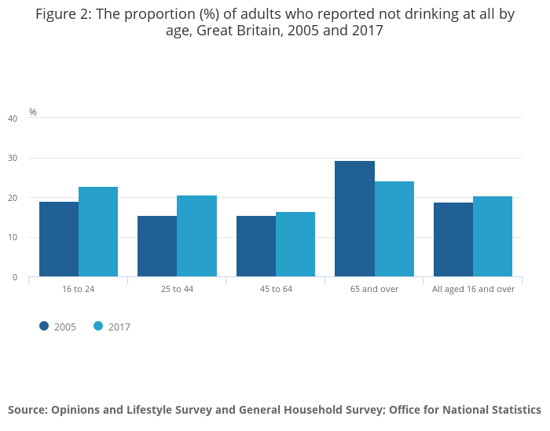
The dynamics of drinking in Britain
Who consumes alcohol?
Percentage adults reporting abstinence by age, 2005 and 2017.
Notes:
All ages 16+ who don’t drink have actually increased over time
2005 18.8
2017 20.4%
There is an increasing trend, particularly amongst under-25s where alcohol is not part of their lives or lifestyle.
If drinking profiles continue as is:
Fewer young people drinking
Fewer parents in 20s and 30s drinking
More older parents and grandparent drinking

Slide 80
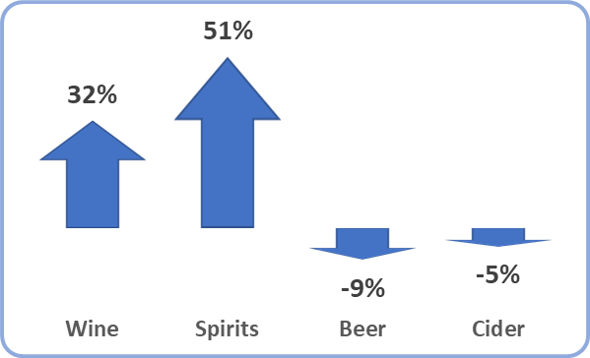
The dynamics of drinking in Britain
The types of alcohol being drunk
Who consumes alcohol?
Changes in sales between 2001/02 to 2021/22.
Percentage adults reporting abstinence by age, 2005 and 2017.
Notes:
Increasing ranges of no or low alcohol drinks being produced, sold and drunk
Catering to those who don’t drink or supports moderation of alcohol consumption

Slide 81


The dynamics of drinking in Britain
Where people drink alcohol
Who consumes alcohol?
The types of alcohol being drunk
Percentage adults reporting abstinence by age, 2005 and 2017
Changes in sales between 2001/02 to 2021/22
Licensed premises
Home
Notes:
As well as a change in alcohol consumption since the turn of this century there has been a change in where people drink.
Moving away from drinking in licensed premises to one where alcohol is bought from supermarkets and other off-license premises then drunk at home
A consequence is people are less likely or able to measure or monitor their consumption

Slide 82
The impact of Covid on alcohol consumption
During the Pandemic
Reduced or stopped drinking.
No change in consumption.
Increased alcohol intake.
Notes:
University of Sheffield
For many their alcohol consumption did not change much.
A distinct minority at both ends of the spectrum reported an increase or decrease in their alcohol consumption (between a fifth and third in both cases)
Institute of Alcohol Studies:
Emerging evidence that it was those who were the most frequent drinking who increased their drinking during lockdown and more people were drinking at higher risk levels

Slide 83
The impact of Covid on alcohol consumption
During the Pandemic
Future Forecasts
Lower risk drinkers
 | Will return to pre-pandemic levels of drinking quite quickly.
Reduced or stopped drinking.
No change in consumption.
Increased alcohol intake.
Notes:
University of Sheffield
The most likely scenario is that lower-risk drinkers who drank within the recommended guidelines would return to their pre-pandemic levels of drinking quite quickly,

Slide 84
The impact of Covid on alcohol consumption
During the Pandemic
Future Forecasts
 | Will return to pre-pandemic levels of drinking quite quickly.
 | Will continue with COVID-level drinking for another five years before reducing to pre-COVID levels within the following five years.
Lower risk drinkers
Reduced or stopped drinking.
No change in consumption.
Increased alcohol intake.
Higher risk drinkers
Notes:
University of Sheffield
Those who were drinking at higher levels than recommended will continue doing so for another five years
Before reducing to pre-COVID levels within the next five years after that.
It is forecast for this scenario. that a there will be an additional 200,00 alcohol-attributable hospital admissions than there would have been if COVID -19 had not happened.
In addition to this there will be approximately 7,000 more deaths over the coming 20 years.
This will not be experienced equally across the population, with those drinking the most and those in the most deprived areas being most likely to experience alcohol-related harm and death.

Slide 85
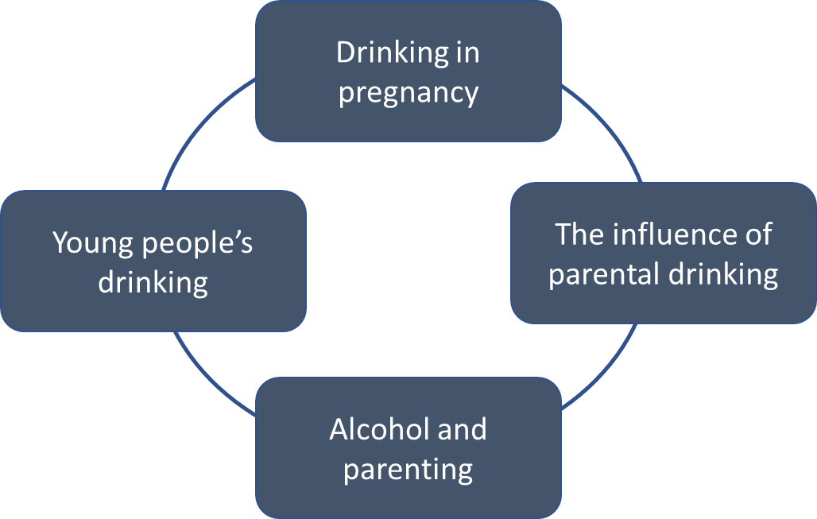
Alcohol in the context of families

Slide 86
Parents are often adults
Nationally, it is estimated that
20% of the adult population do not drink.
56% drink within recommended guidelines.
24% of adults drink more than the low-risk guideline.
Of which 1.4% are dependent.
Notes:
The proportions are contested.
In Torbay, it is estimated that there are approximately 1,500 adults with an alcohol dependency.
This means that for every 1,000 residents, 14 will be living with an alcohol dependency, which is consistent with what is being observed nationally
But a tiny proportion of those whose consumption is an issue

Slide 87
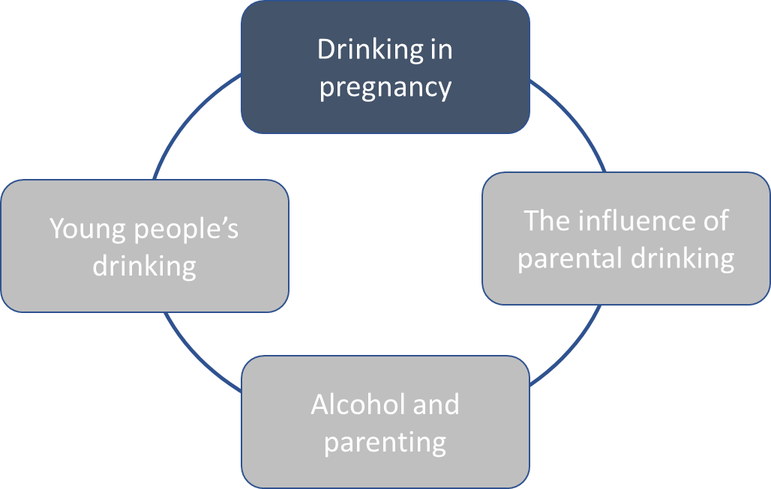

Slide 88
Drinking in pregnancy profile
Prevalence
Approximately 40% of mothers drank alcohol during pregnancy.
Mothers most likely to drink
Living in England
Aged 35 or over
From managerial and professional occupations
From a White ethnic background
Men
Men are more likely to drink at increasing and higher risk levels.
Is some data suggesting that alcohol may affect sperm and overall vulnerability to FASD.
Notes:
Department of Health and Social Care health needs assessment published 2021.
A study in 2017 estimated alcohol consumption during pregnancy in different countries around the world, placing the UK 4th highest (41% drinking during pregnancy.

Slide 89
Drinking in pregnancy profile
Prevalence
Approximately 40% of mothers drank alcohol during pregnancy.
Mothers most likely to drink
Living in England.
Aged 35 or over.
From managerial and professional occupations.
From a White ethnic background.
Men
Men are more likely to drink at increasing and higher risk levels.
Is some data suggesting that alcohol may affect sperm and overall vulnerability to FASD.
Notes:
This does not necessarily fit with the story we tell about young ‘uneducated’ women being the greatest concern

Slide 90
Drinking in pregnancy profile
Prevalence
Approximately 40% of mothers drank alcohol during pregnancy.
Mothers most likely to drink
Living in England.
Aged 35 or over.
From managerial and professional occupations.
From a White ethnic background.
Men
Men are more likely to drink at increasing and higher risk levels.
Is some data suggesting that alcohol may affect sperm and overall vulnerability to FASD.
Notes:
Similarly, the stories often told are about FASD ‘being the woman’s fault or responsibility’
From a policy perspective alcohol consumption by men is important because prevention strategies aim to encourage the partners of pregnant women to reduce alcohol consumption.
It is therefore important to acknowledge the relatively higher risk drinking patterns in men compared to women.

Slide 91
Fetal Alcohol Spectrum Disorder (FASD)
A condition that results in the child's mental and physical defects due to the mother's alcohol consumption during pregnancy.
Notes:
ohol spectrum disorder: health needs assessment
Definition

Slide 92
Fetal Alcohol Spectrum Disorder (FASD)
A condition that results in the child's mental and physical defects due to the mother's alcohol consumption during pregnancy.
Alcohol passes through the placenta and spreads rapidly to the amniotic fluid.
The alcohol is removed from the fluid slower than the mother eliminates it.
Resulting in accumulation in the amniotic fluid.
Notes:
The biology

Slide 93
Fetal Alcohol Spectrum Disorder (FASD)
A condition that results in the child's mental and physical defects due to the mother's alcohol consumption during pregnancy.
Alcohol passes through the placenta and spreads rapidly to the amniotic fluid.
The alcohol is removed from the fluid slower than the mother eliminates it.
Resulting in accumulation in the amniotic fluid.
Even low levels of alcohol exposure may lead to developmental abnormalities, at all stages of embryonic development.
Notes:
What this means

Slide 94
Fetal Alcohol Spectrum Disorder (FASD)
A condition that results in the child's mental and physical defects due to the mother's alcohol consumption during pregnancy.
Alcohol passes through the placenta and spreads rapidly to the amniotic fluid.
The alcohol is removed from the fluid slower than the mother eliminates it
Resulting in accumulation in the amniotic fluid
Even low levels of alcohol exposure may lead to developmental abnormalities, at all stages of embryonic development.
There are lifelong consequences for the child (and family):
The cognitive deficits, behavioural problems, psychopathology and other secondary disabilities associated with FASD.
Affecting the person’s ability to navigate their daily lives and become independent adults.
Notes:
The impact

Slide 95
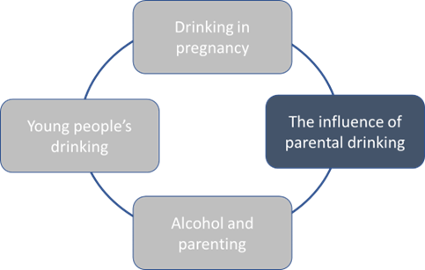

Slide 96

Influence of parents drinking on children
Young people’s drinking behaviours and beliefs are heavily influenced and informed by their parents drinking.
This is more significant if excessive drinking is a feature of the young person or parent.
Notes:
While many of the stories we tell are about ‘peer pressure’
The reality is often much closer to home.
This increases in significance when considering alcohol in the context of family:
Our own as well as with those we encounter and engage with

Slide 97
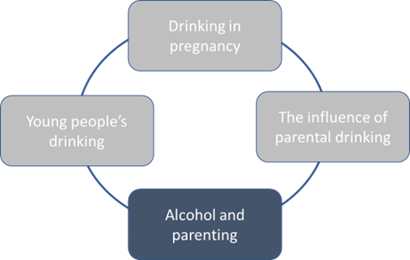

Slide 98

Alcohol and parenting
Notes:
As well as parental influence of their children’s drinking patterns for the future, alcohol can also play a part in a parent’s ability to care for their children and keep them safe.
It is easy for parents to underestimate the implications of consuming or having consumed alcohol whilst being responsible for the safety and care of a child.
The narrative and self-perception can clash with reality more easily than may be realised

Slide 99

Alcohol and parenting
Notes:
How often have parents had ‘a few drinks’ at the weekend and a child in their care has injured themselves?
If that child requires immediate medical care and must be taken to hospital this poses not only the challenge of how to get the child there
But how to answer the questions: is that alcohol I can smell?
Failure to ensure children are kept safe from harm can be mundane

Slide 100

Alcohol impacting on the capacity to parent
Deterioration in family life.
Difficulties in meeting physical and emotional needs.
Diminished physical and mental health.
Notes:
Excessive and regular parental alcohol use can impact on someone’s capacity to parent, negatively affecting children’s health and development.
In the most severe cases, parental drinking can result in abuse and neglect of their children as well as inconsistent and unpredictable parenting behaviour.
Impacts:
Deterioration in family life
Broken routines and missed appointments or family events
Reduced household income
Difficulties in meeting physical and emotional needs
Difficulties in providing adequate supervision and discipline
Impaired judgement
Poor attachment
Keeping safe

Slide 101
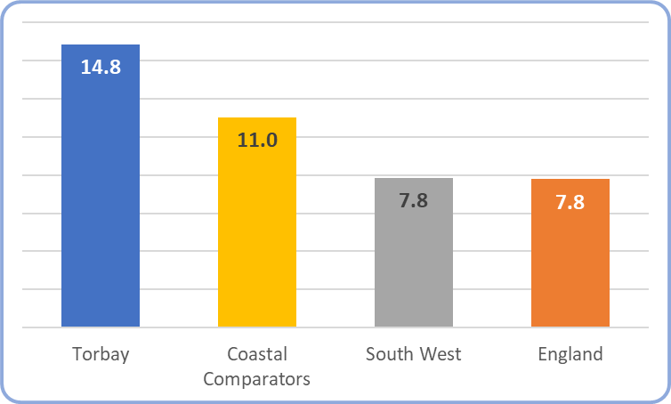
Children in Need in Torbay
Alcohol misuse as a factor in Children in Need assessments – Rate per 1,000 child residents (2018 to 2021).
Notes:
Torbay has a higher rate of Child in Need assessments where alcohol is a factor than for England, the South West and our coastal comparators

Slide 102
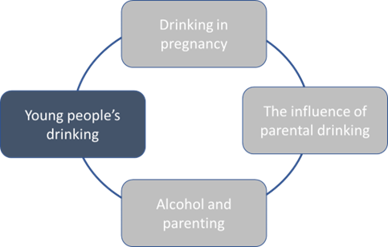

Slide 103
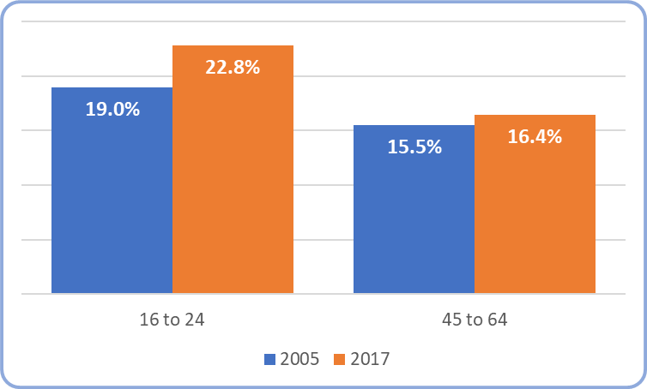
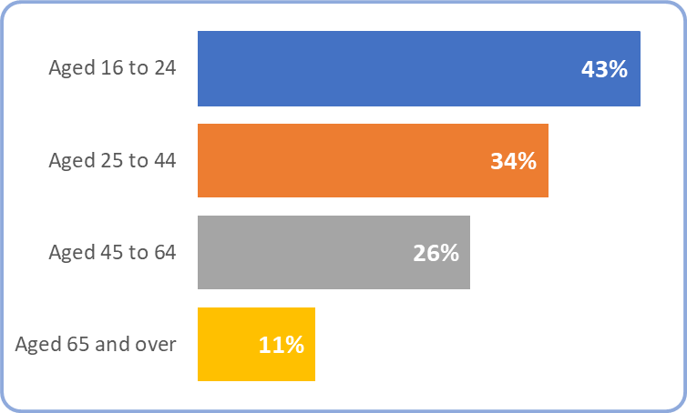
Young people and alcohol: the dichotomy
Who consumes alcohol?
Drinking pattern
Percentage adults reporting abstinence by age, 2005 and 2017.
Among those who drink, the percentage who exceed 6/8 units on their heaviest day, 2017.
Notes:
Young adults aged 16-24 are less likely to drink that any other age group,
But alcohol consumption on their heaviest day of drinking has been found to be higher than all other age groups.
By the age of 17, half of all girls and almost two thirds of boys' drink alcohol every week
The levels of alcohol consumption among our youth within the United Kingdom remains higher than the European average.
Among drinkers aged 16 to 24 years, 37% reported binge drinking on their heaviest drinking day in 2016 compared with just 10% of drinkers aged above the age of 65 years

Slide 104
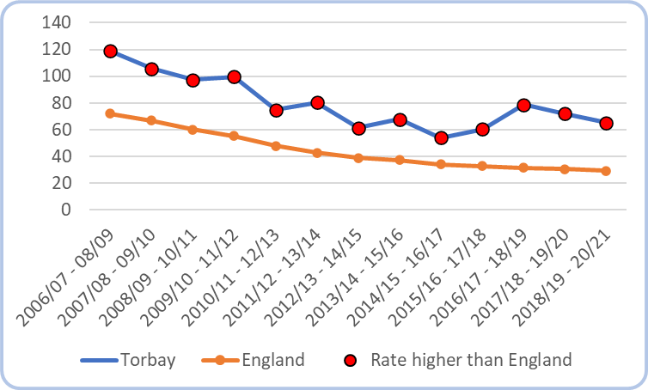
Young people and alcohol harms
Hospital admissions
Dependence
Admission episodes for alcohol-specific conditions, under 18s, per 100,000.
Number and proportion of young people (under 18) in treatment by drinking level units for Torbay and England 2020-21.
Units | % of young people (Torbay) | % of local young people (England)
0 | 33% | 50%
1-199 | 49% | 44%
200-299 | 18% | 4%
300+ | 0% | 0%
Notes:
Youth drinking may cause the young person to have trouble at school or even with the law
Children who begin to drink before the age of 14 are at increased health risks including alcohol related injuries and alcohol dependency in adulthood
While it is only a minority of people who end up in hospital after a heavy drinking session, hospital admission data can be useful in highlighting some extremes in drinking behaviours amongst young people.
Torbay’s young people are experiencing greater levels of alcohol related harm compared to the national average.
Latest data shows that for Torbay the rate per 100,000 young people being admitted is 72, compared to the national average rate of 31.
On a more positive note, however, the general trend for Torbay (as well as nationally) has been a downward one in number of young people being admitted to hospital for alcohol specific conditions.
Alcohol-related harm amongst young people in Torbay is further seen in the levels of drinking reported by the numbers who are receiving support for their alcohol use.
Amongst those young people accessing treatment and support, 18% report consuming between 200 and 399 units of alcohol over a 28-day period in Torbay,
Compares with 4% drinking at this level in the national picture of young people in treatment for drug and alcohol problems.
We are seeing higher consumption levels in Torbay amongst those in treatment.

Slide 105

Treatment for dependency

Slide 106
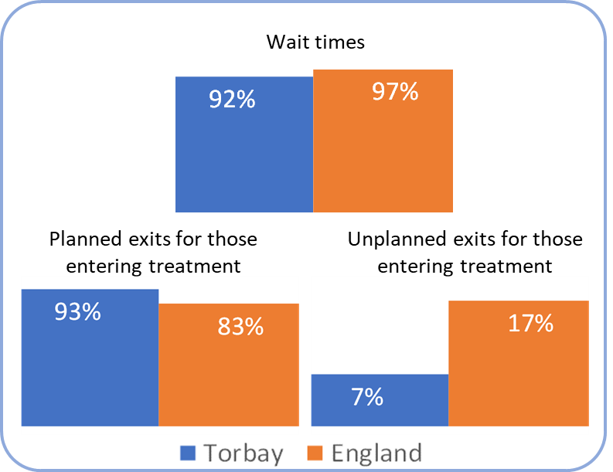
Treatment performance overview: young people
Quarter 2 (June-September) performance compared to England average 2022/23.
Notes:
Number in treatment 2020-21: 54 YP
Torbay: Male 61%; Female 39%
England: Male 64%; Female 36%

Slide 107
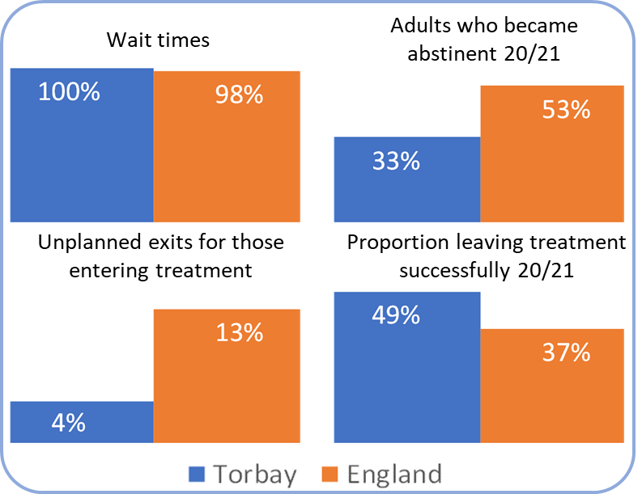
Treatment performance overview: adults
Torbay Treatment performance compared to England average for 2020/21.
Notes:
Number in ‘alcohol only’ treatment 2020-21: 401
Torbay: Male 51%; Female 49%
England: Male 58%; Female 42%

Slide 108

The future focus

Slide 109

What works well
 | Those who are abstinent and drinking within recommended guidelines.

Slide 110

What works well
 | Those who are abstinent and drinking within recommended guidelines.
 | Variable identification and brief advice for at risk drinking. Variation in pathways and their effectiveness into treatment. Variation in integrated practice between range of services.

Slide 111
What works well
 | Those who are abstinent and drinking within recommended guidelines.
 | Variable identification and brief advice for at risk drinking. Variation in pathways and their effectiveness into treatment. Variation in integrated practice between range of services.
 | Effective treatment for young people and adults with an alcohol dependency that is meeting demand.
Notes:
Access to alcohol treatment is important for people who have a dependency on alcohol
The number of individuals accessing specialist support within Torbay is good when compared to those accessing treatment nationally.
Where nationally, 18% of those with a dependency on alcohol access specialist treatment for this, in Torbay this is almost double, with 34% of those who may benefit seeking help.
Within Torbay we are fortunate to have different types of support available to people struggling with an alcohol problem:
Fellowship groups, like Alcoholics Anonymous. Individuals can access AA online or face to face, with meetings available in various locations across Torbay.
SMART Recovery
MCN Alliance (01/02/2022) - The Specialist Alcohol Treatment service. (family members who are affected by a person’s drinking) – community recovery
A range of on-line support interventions are also available, including Silvercloud and Breaking Free Online

Slide 112
Opportunities for improvement and recommendations from DPH Report
 | Celebration of responsible drinking by offering and promoting no and low alcohol options.
1.
Notes:
For local premises to celebrate responsible drinking by offering and promoting no and low alcohol options
Incorporation into Safety night charter training
Exploration of opportunities within Licensing

Slide 113
Opportunities for improvement and recommendations from DPH Report
 | Celebration of responsible drinking by offering and promoting no and low alcohol options.
 | Further partnership working to use recognised alcohol screening tools to identify at risk drinking.
1.
2.
Notes:
Further build on partnership working to use internationally endorsed alcohol screening tools to help people understand if their alcohol consumption is putting them at risk and providing the information and advice to make any necessary changes that may be identified.
Lifestyles and commercial roll outs of MECC
Plan for roll out of MECC
Uptake of AUDIT in the homeless hostel

Slide 114
Opportunities for improvement and recommendations from DPH Report
 | Celebration of responsible drinking by offering and promoting no and low alcohol options.
 | Further partnership working to use recognised alcohol screening tools to identify at risk drinking.
 | Collaborative working between statutory and voluntary bodies to identify those children, young people and families most at risk and supporting them to make changes to their drinking.
1.
2.
3.
Notes:
Promoting collaborative working between statutory and voluntary bodies to identify those children, young people and families most at risk and supporting them to make changes to their drinking.
Review of young people’s drug and alcohol hospital / community support pathway
Identification, response, and pathways/ collaborative working between the Exploitation Team and Young Persons Drug & Alcohol Service

Slide 115
Opportunities for improvement and recommendations from DPH Report
 | Celebration of responsible drinking by offering and promoting no and low alcohol options.
 | Further partnership working to use recognised alcohol screening tools to identify at risk drinking.
 | Collaborative working between statutory and voluntary bodies to identify those children, young people and families most at risk and supporting them to make changes to their drinking.
 | Encouraging the use of bar measures such as shot or wine measures in the home and alcohol tracker apps to help people monitor their intake accurately.
1.
2.
3.
4.
Notes:
Identification, response, and pathways between the Children at Risk Panel and Young Persons Drug & Alcohol Service
Family Hubs / drug & alcohol pathways and collaborative working for children, young people, parents and families.

Slide 116
Opportunities for improvement and recommendations from DPH Report
 | Celebration of responsible drinking by offering and promoting no and low alcohol options.
 | Further partnership working to use recognised alcohol screening tools to identify at risk drinking.
 | Collaborative working between statutory and voluntary bodies to identify those children, young people and families most at risk and supporting them to make changes to their drinking.
 | Encouraging the use of bar measures such as shot or wine measures in the home and alcohol tracker apps to help people monitor their intake accurately.
 | Promoting support offers for those with an alcohol dependency and their family members that are available in Torbay.
1.
2.
3.
4.
5.
Notes:
Promoting the support offers for those with an alcohol dependency and their family members available in Torbay.
DPH report and associated comms
Dry January
?other point of promotion

Slide 117

Questions

Slide 118
Q&A
Executive Panel

Slide 119
Final Remarks
Darryn Allcorn, Chair of Executive

